Slide 1
Reward Those Who Step Up: Helping to Prevent the Burnout of Underrepresented Groups in the Rollout of DEI Activities
ASMS Diversity and Inclusion Committee
Chair: Candice Z. Ulmer, Ph.D.
Tuesday, June 7, 2022
5:45 – 7:00 pm

Slide 2
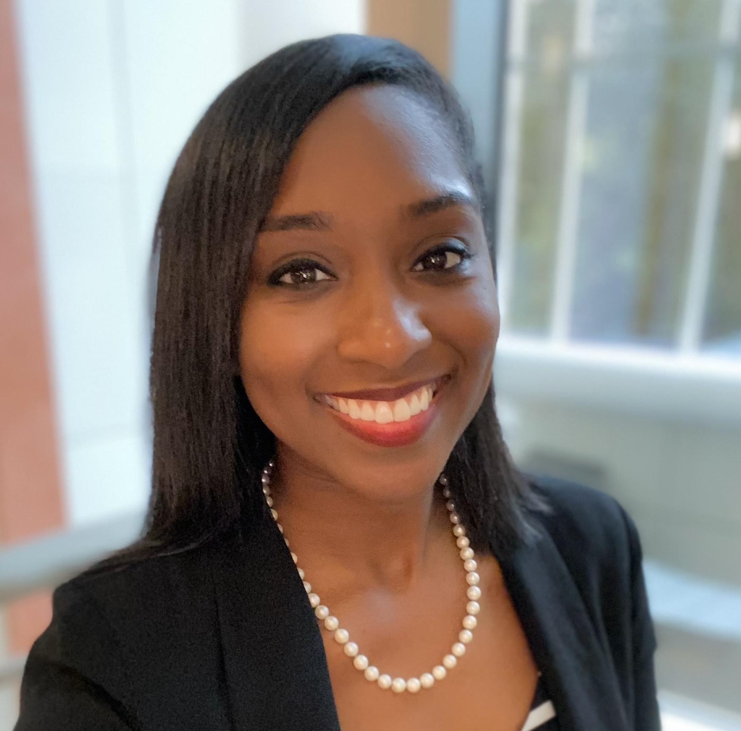
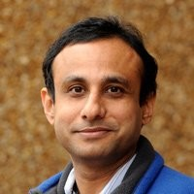
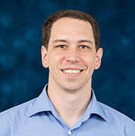
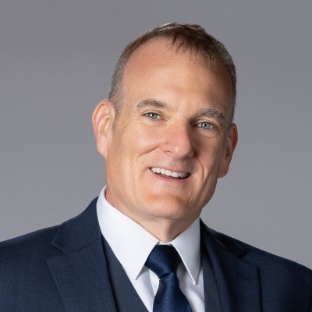
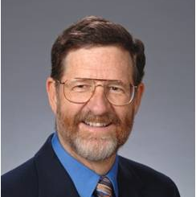
ASMS Diversity and Inclusion Committee
The mission of the Committee is to promote and reinforce diversity within the membership of the ASMS by fostering a culture of inclusion and mutual support. This mission is supported by attention to equity and initiatives to enhance and support a broadly representative membership.
The Committee is charged with the design of activities and projects that promote an inclusive climate and increase participation of ASMS members who represents diverse cultural, gender, social, and scientific backgrounds.
Candice Z. Ulmer (USDA-FSIS)
Chair
Saiful Chowdhury
(University of Texas at Arlington)
Jennifer Campbell
(Matterworks)
Carlos Larriba Andaluz
(IUPUI)
Dominic Gostick
(SCIEX)
Rick Yost
(University of Florida)

Slide 3
Diversity Wheel
Cultural
Power and authority views
Body language
Organizational
Time
Industry
Union affiliation
Being or doing
Secondary
Level
Competition or cooperation
Religion
Education
Role in the company
Geographic location
Conflict resolution preferences
Primary
Communication style
Age
Mental/Physical ability
Location
Marital/ relationship status
Personality
Gender identity
Traditions/ Observances
Ethnicity
Tenure
Sexual orientation
Appearance
Personal space
Sex
Management status
Race
Working style
Parental/Family status
Language/ Accent
Individual or team
Work experience
© Lee Gardenswartz and Anita Rowe. Internal and External Dimensions are adapted from Marilyn Loden and Judy Rosener. Workforce America! (Business One Irwin, 1991)
Division/Department
Flexible or structured
Notes:
Time Max: 3 minutes
Notes:
Please note that this is a progressive slide, there are 3 sections so please be mindful
Ask participants: When we think about diversity, what dimensions come to mind?
We often think about visible or “primary” dimensions of diversity such as race, gender, sexual orientation, age, physical ability and ethnicity because those are more “visible.”
It’s important to know that there are many dimensions of diversity to consider - some which are visible and some which aren’t.
CLICK to activate animation on external rings.
These layers of secondary, organizational, and cultural diversity include aspects of our lives which we have some control over. Some might change over time, and some form the basis for decisions on careers and work styles.
Ask the following rhetorical questions. (No replies are needed.):
When you look at the wheel, think about the one or two dimensions that you’re most comfortable with. Why is that? Maybe it’s because you were exposed to them frequently and have had positive experiences.
Now think about 1 or 2 dimensions of diversity that you’re least comfortable with. Why is that? It’s likely because you’ve had less exposure to them, so they’re out of your comfort zone.
It’s important to note that blind spots and biases can impact any of these dimensions of diversity. So let’s dig deeper into biases now.
<Move to next slide>

Slide 4
DEIA Assessment
DEI assessment (Diversity, Equity & Inclusion) is a process for obtaining valid data and information about the performance of an organization on key DEI factors. Assessment is a critical step to long-term success, as it provides a data-driven understanding of organizational current state around DEI. It facilitates identifying opportunities to deepen DEI commitment and guide decisions around strategic resourcing and action planning. Assessment also establishes a baseline from which to celebrate what is working well, and measure progress along your DEI journey.
Notes:
Many workplaces and laboratories have committed to eliminate barriers associated with job opportunity and professional development equity, establish more inclusive and accessible environments, and improve the success/retention of individuals from underrepresented and/or underserved groups. As a result, scientists have witnessed the birth of internal diversity, equity, inclusion, and accessibility (DEIA) strategic plans, mandatory training modules, DEI task groups, and other activities. However, these roles are often disproportionally filled internally by scientists from the same underrepresented groups that the DEI initiatives were intended to benefit (e.g., womxn and minorities), added on top of their normal workloads, and accepted with no added incentives, benefits, and/or recognition. Therefore, this workshop will provoke a discussion on best practices and effective strategies to mitigate the burnout of underrepresented groups in the rollout of DEI work.

Slide 5
DEIA Assessment
Conversations about inclusion and diversity are familiar to our organization
The demographic makeup of my organization’s leadership is diverse.
We have qualitative/ quantitative data from our employees on their experiences in the workplace
We have facilitated conversations to hear our employees’ experiences with diversity and inclusion in our organization (focus groups, mediated dialogue)
We measure employee engagement:
At our company, employees appreciate others whose race/ethnicity is different from their own
Our company makes our organizational strategy, values, and mission clear and I know what they are
DEI is included in our organization’s core beliefs/values
Our senior leaders have participated in unconscious bias training
We have offered training/ communications on key terms involving diversity, equity, inclusion and the key elements that foster it
Our leaders have received inclusive leadership professional development or coaching in DEI
https://www.thecentermsu.org/uploads/editor/files/Complete_Comprehensive_DEI_Assessment.pdf
Notes:
Many workplaces and laboratories have committed to eliminate barriers associated with job opportunity and professional development equity, establish more inclusive and accessible environments, and improve the success/retention of individuals from underrepresented and/or underserved groups. As a result, scientists have witnessed the birth of internal diversity, equity, inclusion, and accessibility (DEIA) strategic plans, mandatory training modules, DEI task groups, and other activities. However, these roles are often disproportionally filled internally by scientists from the same underrepresented groups that the DEI initiatives were intended to benefit (e.g., womxn and minorities), added on top of their normal workloads, and accepted with no added incentives, benefits, and/or recognition. Therefore, this workshop will provoke a discussion on best practices and effective strategies to mitigate the burnout of underrepresented groups in the rollout of DEI work.

